Slide 1
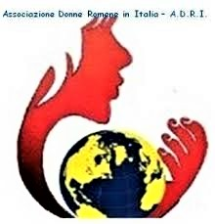
“Italian Syndrome”
with Respect to Romanian Care Workers in Italy, along with the Care Gap Created in Romania
Silvia Dumitrache
President of Association of Romanian Women in Italy (ADRI)
Email: adri_milano@live.it
Tel: +393343540648
https://adriassociazione.wordpress.com/

Slide 2
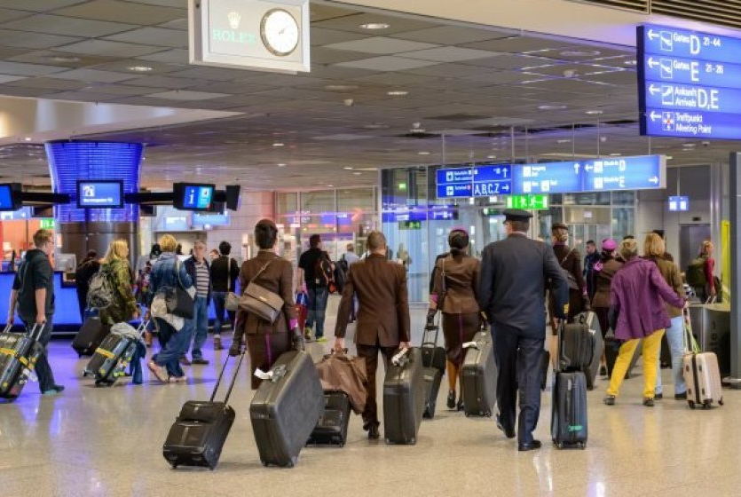
- More than 5.6 million Romanians are living and working abroad, according to 2019 Organisation for Economic Co-operation and Development (OECD) data
- Number of Romanians in Italy: 1,190,091 of whom 670,975, accounting for 57.7% women
Notes:
Most women work as care workers and in agriculture, while men work in constructions and farming.
There are over 1,2 million Romanian citizens in Italy (2 million according to unofficial sources). Many arrive with the intention of going back to their country of origin, but only a few of them do so. If they lose their job in Italy, they try to move to another EU country, waiting for the right moment to repatriate. - file:///C:/Users/HP/Documents/bibliografie/1563266477_0.pdf

Slide 3
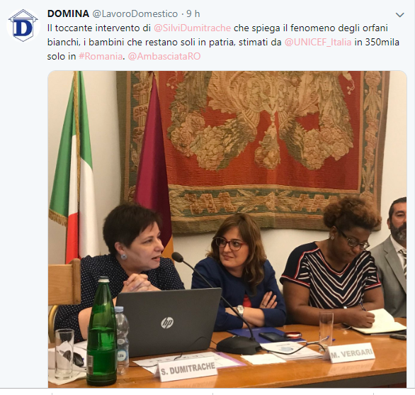
The Romanian community is the largest one in Italy with about 1,2 million of resident citizens.
Unfortunately, we do not have reliable data and studies showing accurately the situation of Romanian citizens undertaking this job, so important for Italian families. From what we know, the majority are women, with different qualifications.
The majority of Romanian workers taking care of children and elders are not accompanied in Italy by members of their families.
Notes:
Most of them have a high school leave, and usually a degree. These people could not support their family in Romania and therefore have decided to come and work in Italy. When they arrive in Italy, most of them speak no Italian and are not familiar with the Italian legislation, leading them through situations of hardship, in addition to the suffering caused by the separation from their families and children. A more complete and clearer information and professional trainings are needed before leaving for Italy; the improvement of knowledge concerning rights and duties of the National Collective Bargaining Agreement (CCNL) would make workers more aware of their job and less exploitable. There are also other issues linked to the cohabitation, stemming from communication, cultural differences, and linguistic problems. Not being able to cook Italian dishes or to use certain appliances could become a source of conflicts resulting in insults, but also to more serious violence towards the worker. Some of these violent behaviours are perhaps unintentional, as perpetrated by an assisted person already aggressive due to his or her disease (as for Alzheimer) but it remains a risky situation for workers. In many cases, caregivers carry out stressful and dangerous jobs, with a too high “toll” for their health. Only a few caregivers turn to a doctor, even though they suffer from insomnia, anxiety or depression. The absence of national controls leaves too much room for labour exploitation, abuse, and ill-treatment by their employers
Indeed, the irregular work phenomenon is quite widespread (Censis), about 6 hours of work out of 10 have no social security coverage, outside the realm of rules, safeguards, and guarantees provided by law. Sometimes, workers prefer to work irregularly for higher retributions, underestimating risks and consequences this entail: the lack of sanitary insurance, the payment of the social security contributions, the lack of protection, rights, and sanctions foreseen by the law. They work irregularly, at a high pace, without leave permits, nor free Saturdays nor Sundays, sleep deprived and with no longer a private life and the possibility to socialize, far from their families and their country; all this leads these people in conditions of fragility and vulnerability. In order to face such an issue, a government programme to welcome and solidly train these people is needed. INPS decided to initiate a awareness-rising and information campaigns focusing on employers, by using means of communication like bread bags or napkins of the fast food shop. The message to convey is a correct behaviour for those who employ these domestic workers, immigrants and local, to prevent future workers from facing situations of extreme precariousness, with a very low pension due to tax evasion. 8 Legislative action is needed, for example, as domestic work is not among the several incentives for the new recruitments like the South bonus (bonus Sud) and is not included in the new legislation on the traceability of salaries. All these anomalies make this sector a breeding ground for illicit practices. Intervista a Silvia Dumitrache @Domina file:///C:/Users/HP/Documents/bibliografie/1563266477_0.pdf

Slide 4
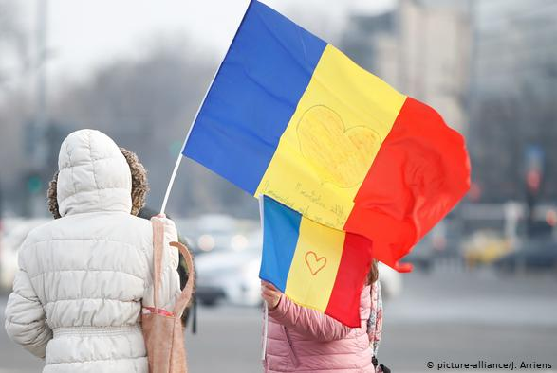
Separated families, children and the elderly left behind: 1 million elderly citizens left behind;
Out of 5 million children in Romania 750,000 have lived through the experience of separation from at least one parent;
According to UNICEF data 350,000 children have at least one parent who left to work abroad, mostly the mothers.
Notes:
- Romania is the country boasting the largest number of adolescent mothers and newborns abandoned in maternities in the Easter Europe (many of them with their mothers away for work abroad) and also a steep incidence of infant mortality. Five out of ten mothers under 18 have never had a gynecological check-up (control ginecologic);
- A 2018 European Commission Report shows that almost three quarters of trafficking victims (traficului de persoane) in the EU came from Romania

Slide 5
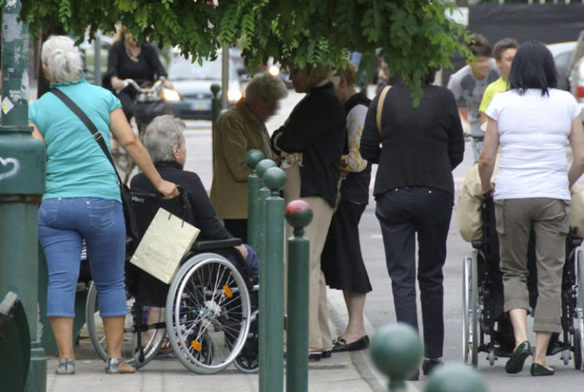
"Domestic work involves over two million domestic workers of whom only 859 thousand are legal and 1.5 million families allow the state to save ten billion Euro for assistance to the elderly"
7 out of 10 retirees cannot pay a caregiver
Notes:
Avvenire https://www.avvenire.it/economia/pagine/lavoro-domestico-oltre-due-milioni-di-lavoratori-ma-solo-859mila-regolari?fbclid=IwAR1KC5fnD51ixrCuftpXuy_MrDM6Mr0AbYibqmxhHulWTV5uoPqsFrz8kvw

Slide 6
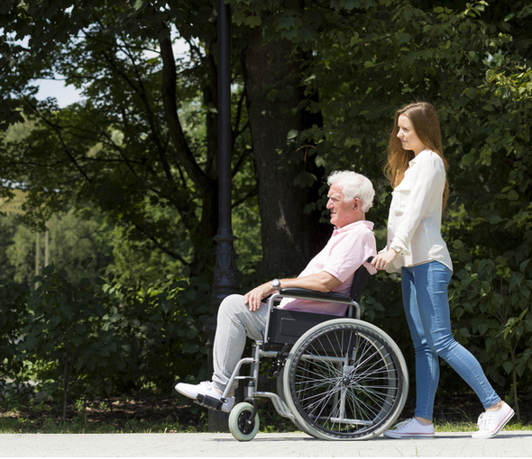
Sanatoria: regularization of foreign workers
The Italian government’s attempt, in 2020, to regularize foreigners without an employment contract has not been a success. Too much bureaucracy, taxes and unclear provisions have led to the regularization of 1 in 3 undeclared workers.
As far as domestic workers are concerned, the bankruptcy is even more dramatic: 177 thousand illegal reports have emerged referring to workers without a residence permit (a situation in which about 250 thousand people were found), but still one million Italian workers remained in the shadows, EU citizens or in any case legally resident in the country for which it is more convenient not to declare anything.
Notes:
https://www.hrw.org/news/2020/12/18/italy-flawed-migrant-regularization-program; https://it.businessinsider.com/la-sanatoria-bellanova-per-colf-e-braccianti-e-un-flop-allinps-1-084-domande-per-regolarizzare-il-lavoro-in-nero/

Slide 7
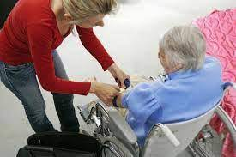
The category of caregivers has been ignored by the Italian government during the pandemic, they were not given any financial assistance.
The care givers who returned from Romania did not have any place to quarantine: they were not allowed at their workplace, hotels were too expensive. The Milan city hall provided free hotel rooms for only a handful of people.
Many were stuck in Italy and couldn’t go see their families.
Many lost their jobs because the families they assisted worked from home.
Many accepted reduced pay and worked illegally.

Slide 8
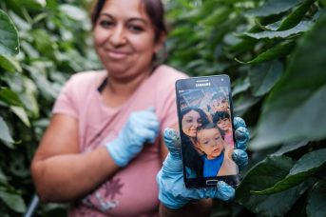
Longing for one’s children is the most unbearable suffering for the Romanians working aboard, more painful than the feeling of temporary status of their lives as migrant workers in Europe.
„You can make money, but the distance from your child kills you.”
@Libertatea

Slide 9
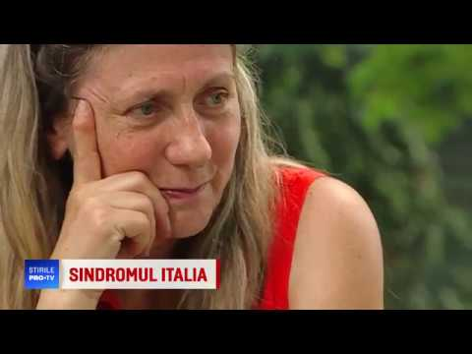
Domestic work is today one of the most tiresome and consuming jobs.
In many cases, caregivers carry out stressful and dangerous jobs, with a too high “toll” for their health. Only a few caregivers turn to a doctor, even though they suffer from insomnia, anxiety or depression. The absence of national controls leaves too much room for labour exploitation, abuse, and ill-treatment by their employers.
Notes:
The irregular work phenomenon is quite widespread (Censis), about 6 hours of work out of 10 have no social security coverage, outside the realm of rules, safeguards, and guarantees provided by law. Sometimes, workers prefer to work irregularly for higher retributions, underestimating risks and consequences this entail: the lack of sanitary insurance, the payment of the social security contributions, the lack of protection, rights, and sanctions foreseen by the law. They work irregularly, at a high pace, without leave permits, nor free Saturdays nor Sundays, sleep deprived and with no longer a private life and the possibility to socialize, far from their families and their country; all this leads these people in conditions of fragility and vulnerability. file:///C:/Users/HP/Documents/bibliografie/1563266477_0.pdf
The symptoms were so specific that back in 2005 two Ukrainian psychiatrists, Andriy Kiselyov and Anatoliy Faifrych, identified it as a socio-medical condition and named it the "Italian syndrome.“https://www.dw.com/en/romanian-carers-in-italy-i-miss-my-family-so-so-much/a-48110728

Slide 10
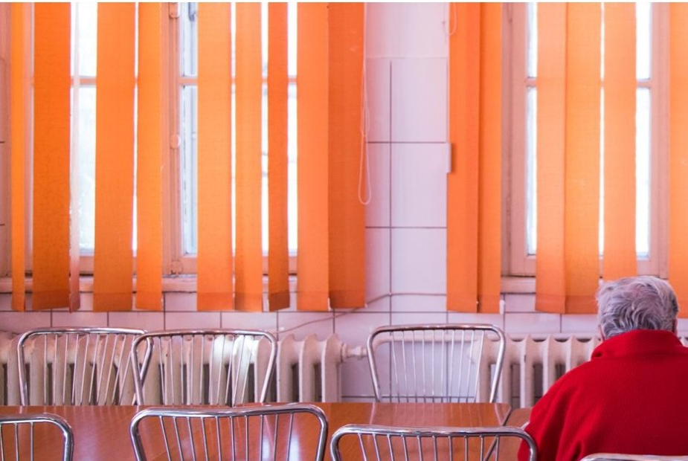
There is a specialized clinic in Iasi, Romania, where hundreds of caregivers have been hospitalized in past years, because of depression and other psychiatric disorders. Romanians comprise the largest group of migrant workers in Italy. But when they go back to Romania, usually these women find broken families, grown-up sons who do not recognize them, and husbands who squandered their money or left them. The mental disease that results from the impact that work-based migration has on these women is called the "Italian Syndrome". @Corriere della sera
“More than a disease, ‘the Italian syndrome’ is a medical-social phenomenon,” explained Petronela Nechita, consultant psychiatrist at the Iasi clinic
Notes:
In the Socola clinic in Romania, this disorder has been addressed to. In milder cases, anxiogenic states, identity disorders, eating and sleep disorders, somatoform and dissociative disorders have been registered. In the most serious cases, the patients presented psychotic behaviours, obsessive-compulsive disorders, paranoid and schizoid disorders and depressions; these, in the most severe forms, can lead to suicide. file:///C:/Users/HP/Documents/bibliografie/1563266477_0.pdf

Slide 11
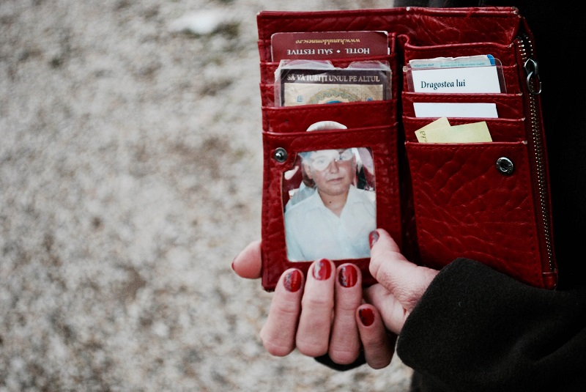
Many domestic workers (mainly women) live in the same house with the assisted person and work without respecting rest periods, with the high risk of suffering from the burnout syndrome: a kind of stress afflicting several workers and professionals dealing with interpersonal relations activities. Often, workers are left alone to care for elders and they feel even lonelier because of the separation from their families.
Notes:
The burnout is a concept referring to 35 one of the main risks of the caregiving occupation. It is a condition of discomfort, uneasiness, impotence, suffering, generated by emotional stress and caused by constant contact with situations of suffering; it is manifested through emotional exhaustion, a feeling of lack of personal fulfilment and depersonalisation of one's work. The caregivers’ burnout manifests from emotional resources, as they end up being alienated and emptied from their own job. Sometimes, a behaviour of denial (depersonalisation) towards the assisted ones can prevail (rude answers, negative behaviours toward the assisted one). Often, all this is accompanied by a feeling of inadequacy, lack of self-esteem and a feeling of failure in one's work. Usually, those who face burnout are fundamentally generous, selfless people really willing to help others; however, under particularly stressful conditions and in the absence of a real acknowledgement of their work by the assisted person and the family, they fail to elaborate the frustration that derives from it; and by not taking care of their own needs, they end up falling into a state of depression, dissatisfaction, tension, anxiety, with the desire to leave work. Under conditions of stress, these people develop the following somatic symptoms: fatigue, frequent headaches and gastro-intestinal disorders, shortness of breath, and psychosomatic phenomena (ulcers, back pain, tachycardia, nausea), decreased immune defences, sleep disturbed by negative thoughts and nightmares, and increased propensity to accidents. In addition, psychological symptoms appear too: feelings of guilt towards the elderly, or towards their abandoned family, feelings of failure, resentment, and cynicism towards the assisted person, aggression, suspicion, paranoia, mood instability. As a result, depressive feelings, resistance to care work and little contact with one's own needs are found. Sometimes, this complex situation can lead to drug or alcohol abuse or even gambling addiction. These symptoms are often accentuated by the distance of family members and the concern for children, for the husband, and sometimes for their sick parents. Furthermore, there is a lack of a social network of support (friends, relatives...) who can “nourish” the worker completely consumed by the caregiving job. Often, many caregivers coming from Eastern Europe go back home. In recent years, we have witnessed a psycho-social phenomenon that affects many of the family assistants who have returned from Italy: the Italian syndrome. This is a phenomenon that affects caregivers (especially Romanian, Moldovan, and Ukrainian) who have assisted elderly people in Italy, who have stayed close to those who could barely pay them, or in situations of difficult cohabitation 36 that they have caused them to fall ill. The anxiogenic and depressive states presented by these women appear to be linked to a profound fracture of identity, accompanied by a weakening sense of motherhood, feeling of guilt and shame.

Slide 12
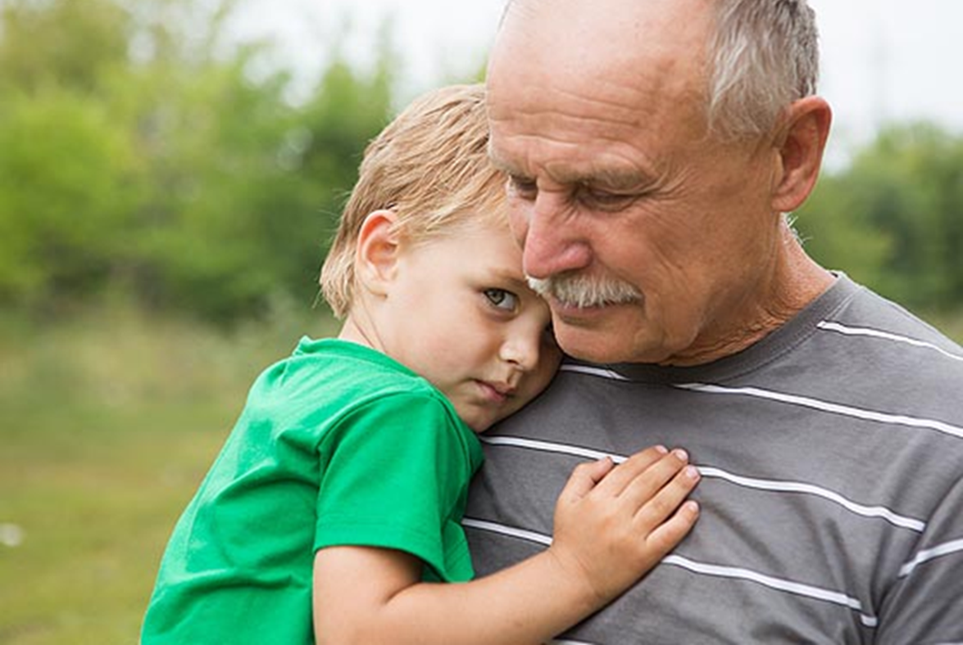
It is not only the women working in Italy who are affected by the upheaval — the impact is also felt in their families and in Romanian society as a whole.
Back home, the children and the elderly formerly looked after by these women, are now themselves lacking care — creating a gap that the Romanian state has not been able to fill.
More than 100 suicides and killings among children left behind and family members have been documented by the media.
Notes:
"We see many Romanian men taking over the household activities. But sometimes they don't accept being financially dependent on their wives who live abroad, and they refuse to take their place," she said.
In both scenarios there is a lack of support both for the women who leave and for the families who stay, said Silvia Dumitrache, founder of the Association of Romanian Women in Italy (ADRI).
To date, there are still "no points of reference, like social workers or organizations, that can care for these families," she told DW. "Romania is broken; the entire country is in an anomalous situation."
https://www.dw.com/en/romanian-carers-in-italy-i-miss-my-family-so-so-much/a-48110728

Slide 13
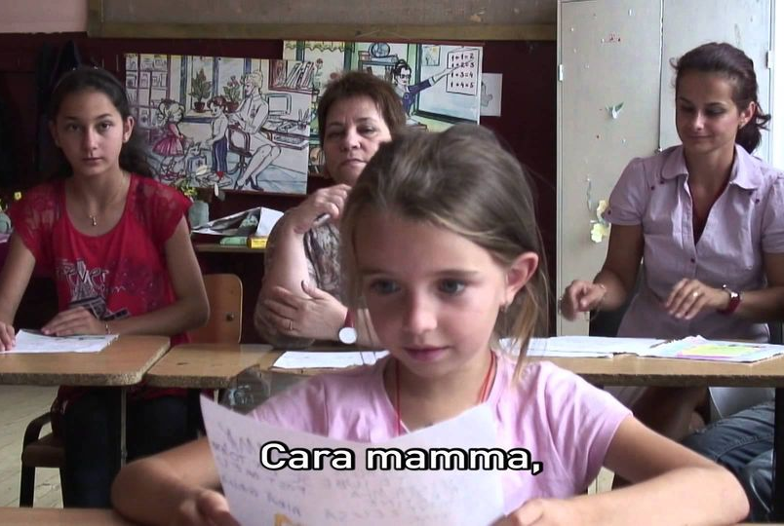
Another issue concerning domestic workers is the “white orphans” phenomenon, that is children left to the care of one parent, or grandparents or in orphanages in the country of origin. According to UNICEF data, there could be at least 350 thousand “white orphans” in Romania, 100 thousand in Moldova. On the one hand, we have children left home alone, on the other, there are female workers struck by the Italian syndrome, a kind of depression due to what they go through in the country.
Notes:
Leaving millions of labour migrants’ children without parental care is a violation of human rights https://pace.coe.int/en/news/8022/leaving-millions-of-labour-migrants-children-without-parental-care-is-a-violation-of-human-rights-

Slide 14
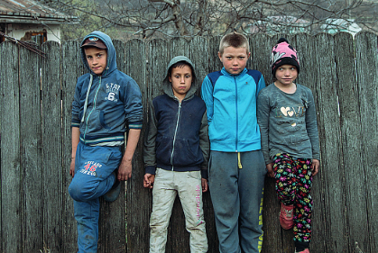
Identified Issues:
Deviant behavior in the case of children left behind in long-distance family relationships;
Increase in human trafficking for sexual and labor exploitation (74% of victims of trafficking in persons in the EU came from Romania, according to 2015-2016 data.)
Notes:
c. There is a higher risk of encountering criminal groups or even becoming victims of such groups. However, the major impact is present at psychological level, at the level of personality formation. The fact has been highlighted that the absence of a parent or of both parents is conducive to low self-esteem, feelings of guilt, and a high level of anxiety.
d. Increased risk of school drop-out rate (abandon scolar). In 2017, nearly 200 high school students dropped out. Their number keeps going up by 13,000 a year.
e. Higher numbers of broken families
f. Escalation of cases of abuse in the family and domestic violence.
g. Need for prevention and combating of trafficking in human beings and labor force exploitation.

Slide 15
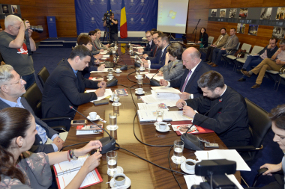
Round table on „Free circulation of care workers, effects on family and society”, organized by the Policy Department for Romanians Everywhere in partenership with Association of Romanian Women in Italy – ‪ADRI‬.
Its aim: to debate ways government bodies can help prevent the effects of economic migration on families left behind, in the context of labor force mobility.
Notes:
\Ministrul delegat pentru relațiile cu românii de pretutindeni, Dan Stoenescu, a participat azi, 31 mai 2016, la masa rotundă „Libera circulație a lucrătorilor, efecte asupra familiei și societății”, organizată de Departamentul Politici pentru Relația cu Românii de pretutindeni din cadrul Ministerului Afacerilor Externe și Asociația Femeilor Române din Italia – ADRI. 2016.05.31
Evenimentul și-a propus relansarea unei dezbateri publice legate de modalitățile în care instituțiile guvernamentale să vină în întâmpinarea efectelor produse de plecarea românilor la muncă în străinătate asupra familiilor rămase acasă. https://www.mae.ro/node/37285

Slide 16
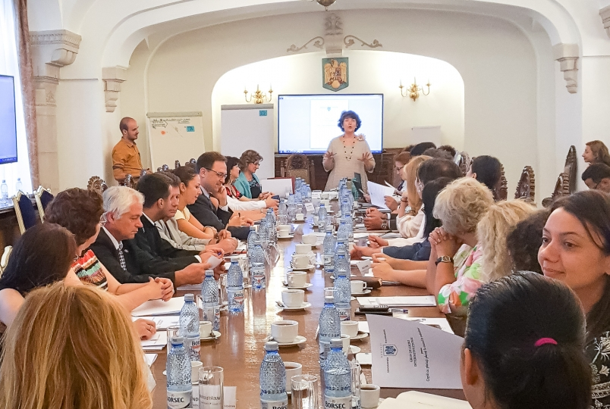
Meeting of the interinstitutional Working Groupului devoted to the situation of children whose parents work abroad (străinătate).
The meeting was a follow-up to the previous governmental one and it was hosted by the presidential administration.
(DPRRP/MAE in partenership with ADRI)
Notes:
RAPORT Grup de Lucru Interinstituţional pentru Copiii cu părinţii plecaţi la muncă în străinătate (CCPPMS) https://www.presidency.ro/files/userfiles/Raportul_Grupului_de_lucru_Interinstituional_dedicat_situaiei_copiilor_cu_prini_plecai_la_munc_in_strintate.pdf
3 Întrunită la propunerea Asociaţiei Femeilor Românce din Italia (ADRI), iniţiatoarea proiectului “Te iubeşte mama!".

Slide 17
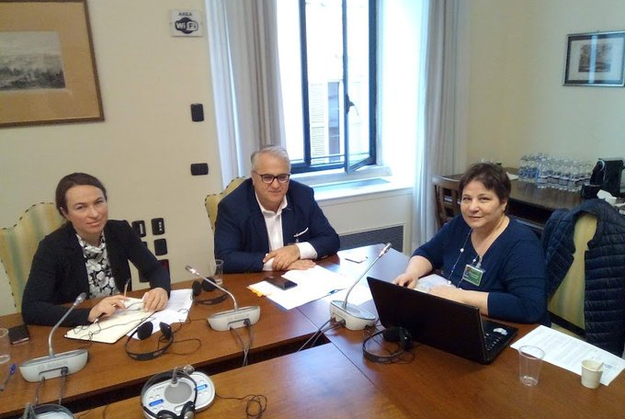
States should privilege a form of labour migration which enables children to migrate together with their parents if they so wish.
In the longer term, destination countries should seek to reduce their reliance on what is considered a cheap, flexible source of labour, while countries of origin should seek to reduce their dependency on remittances sent home by workers abroad.
Venue: Parliamentary Assembly/Council of Europe
“Impact of labour migration on children left-behind” – Report of the
Committee on Social Affairs, Health and Sustainable Development
Rapporteur: Mr Viorel Riceard BADEA, Romania
Notes:
“The parliamentarians called for a series of measures, including social and educational support for children “left-behind”, fair family reunification policies, and more legal avenues for migration to reduce the risk of exploitative working conditions.
Impact of labour migration on children left-behind
Report1
Committee on Social Affairs, Health and Sustainable Development
Rapporteur: Mr Viorel Riceard BADEA, Romania
https://pace.coe.int/pdf/2523456dfd4a5d03afb40b2deebb3d3f36f61bfb3326667a8259ffe25682ae848428feba12/doc.%2015173.pdf
https://pace.coe.int/en/files/28843#trace-3
https://pace.coe.int/en/files/28741#trace-2
Impact of labour migration on children left-behind
Report1
Committee on Social Affairs, Health and Sustainable Development
Rapporteur: Mr Viorel Riceard BADEA, Romania
https://pace.coe.int/pdf/2523456dfd4a5d03afb40b2deebb3d3f36f61bfb3326667a8259ffe25682ae848428feba12/doc.%2015173.pdf
https://pace.coe.int/en/files/28843#trace-3
https://pace.coe.int/en/files/28741#trace-2
All countries need to acknowledge the scale of this phenomenon and the long-term damage it creates, and to put in place comprehensive approaches to labour migration, which are child-centred, human-rights based, gender-sensitive and socially and economically sustainable,” the committee said. https://pace.coe.int/en/news/8022/leaving-millions-of-labour-migrants-children-without-parental-care-is-a-violation-of-human-rights-
States should privilege a form of labour migration which enables children to migrate together with their parents if they so wish, the parliamentarians added.
In the longer term, destination countries should seek to reduce their reliance on what is considered a cheap, flexible source of labour, while countries of origin should seek to reduce their dependency on remittances sent home by workers abroad.
PACE Social Affairs Committee has said it deplores the complacency of both countries of origin and destination concerning children who are “left behind” when their parents migrate abroad for work, potentially depriving them of support and protection.
“Leaving millions of children without parental care is a mass violation of human rights, and an unnecessary threat to the stability and prosperity of our countries,” said the committee, approving a draft resolution based on a report by Viorel Badea (Romania, EPP/CD).
The parliamentarians called for a series of measures, including social and educational support for “left-behind” children, fair family reunification policies, and more legal avenues for migration to reduce the risk of exploitative working conditions.
https://pace.coe.int/en/files/28741#trace-2

Slide 18
PACE Social Affairs Committee has said it deplores the complacency of both countries of origin and destination concerning children who are “left behind” when their parents migrate abroad for work, potentially depriving them of support and protection.
“Leaving millions of children without parental care is a mass violation of human rights, and an unnecessary threat to the stability and prosperity of our countries,”
Notes:
Leaving millions of labour migrants’ children without parental care is a violation of human rights https://pace.coe.int/en/news/8022/leaving-millions-of-labour-migrants-children-without-parental-care-is-a-violation-of-human-rights-

